Slide 1


3 December, 2022
Sponsored and Supported by:

Slide 2






A One Day In Person Event
Win exiting prizes!
Lenovo M10 FHD Plus (2nd Gen)
JBL Tune 125TWS
boAt Blaze Smart Watch
Hands on sessions by experts and community leaders
Deep-dive into Microsoft 365 Services
Focus on:
Microsoft Teams
Power Platform
SharePoint
Cool Water Bottle
Developer Road Ahead

Slide 3


SPEAKER PROFILE
Session 6
Track 2
Developing Dynamic Components using Power Pages
Bhargav Reddy
Solution Architect
Tata Consultancy Services
45 Minutes
https://www.linkedin.com/in/bhargavreddynuthanakalva
@ronnybhargav

Slide 4






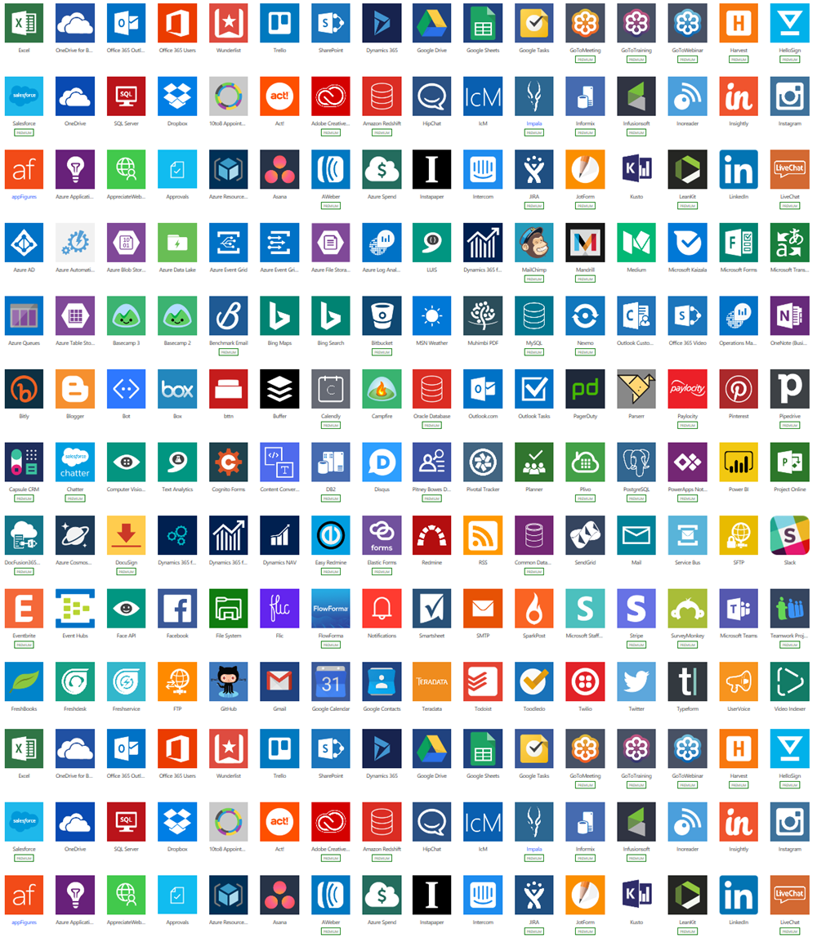





NO CODE
Drag and Drop Functionality like Power Point aiding in Rapid Productivity
Power Apps Application development
Power Pages Website Development
Power Virtual Agents Intelligent virtual agents
LOW CODE
Drag and Drop Functionality plus Excel-like Formulas(using Power Fx) for applying business rules and transforming data
Dataverse Business data platform
PRO CODE
Solutions developed by Professionals and is extensible across Microsoft such as Office 365, Azure or Windows
Power BI Business analytics
Power Automate Workflow automation

Slide 5






Power Pages
Best in class Pro-dev tooling in Visual studio code
Key capabilities
Low-code website development and business data modeling
Build custom controls
Best in class pro-dev tooling to extend and customize
Business data layer APIs
Robust and scalable enterprise- grade hosting platform
Add dynamic content to web pages
Enterprise-grade ALM for CI/CD with GitHub and Azure Dev Ops
Better together

Slide 6



Turnkey integration with Azure Web Application Firewall
Enhanced security and governance
Total control over who takes the site public
Go Live checklist
Site responsive with turnkey Content Delivery Network support

Slide 7
170%
year-over-year
growth
Citizen services
Application processing
Registration
FAQ
Partner portals

Slide 8




The Experience
Fusion Teams
Microsoft Power Pages is centered around the Low-Code concept, but the biggest difference is that it is connected to a full enterprise-grade hosting platform which is the backbone called Dataverse that enables Fusion Teams to collaborate and develop cloud and data-centric websites quickly. Fusion Teams are a collaborative group that makes up of three personas
Low Code Web Site Maker
Site Administrator
Pro Developer
A Low Code Web Site Maker has enough technical knowledge to understand pages, website interactions, content and can build low code websites.
A Site Administrator is responsible for Governance, Security, Compliance and taking actions such as setting up Domains and SSL Certificates.
A Pro Developer persona develops using C# Code, API’s and other complex work through tools such Visual Studio Code, Power Platform CLI etc.

Slide 9







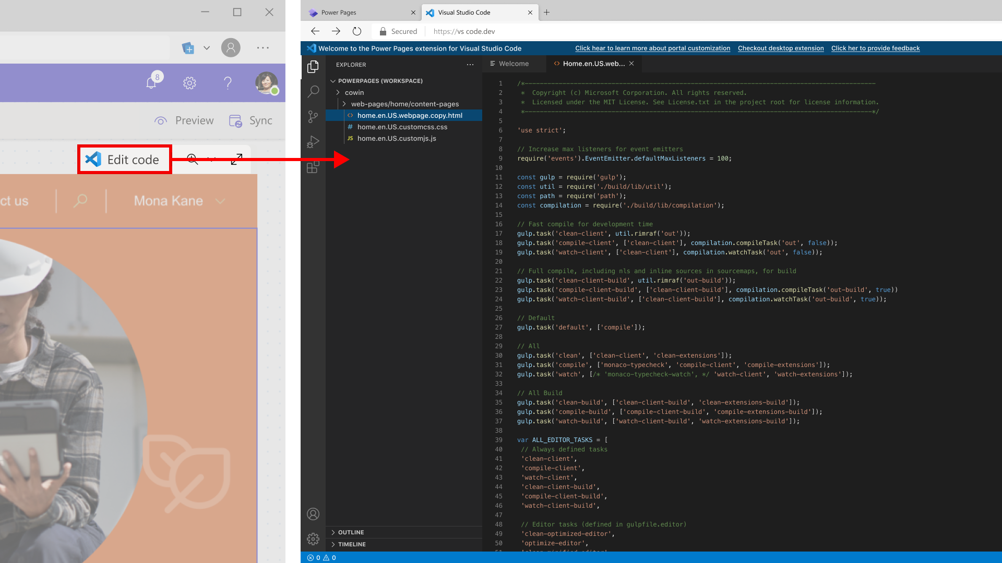
Explore
Tools and Pre-requisites
Best-in-class Pro-dev tooling
VS Code Web
VS Code
GitHub
Azure Dev Ops
Tools needed
Site
Microsoft 365 E5 Trial Account
Power Platform Community(Developer) Plan
Dataverse Environment
Create a Solution for Components
Extensibility
Visual Studio Code
Power Platform Tools Extension
Power Platform CLI
XRMToolBox

Slide 10






Current State
Federated
Trusted
Anonymous
O365
Power Platform
AZURE AD
Public Facing Site
UI
UX
HTML
Bootstrap
CSS
JavaScript
jQuery
Others
POWER PAGES
Pages
Sections
Components
Navigation
Relationships
Authentication
Authorization
Branding
Canvas
POWERAPPS PORTALS
Model Driven
Advanced Forms
Page/Web Templates
Dynamics 365
Mappings/Link Sets
Access Rules
Web Roles
Website Bindings
DATAVERSE
Liquid Tags
Liquid Programming
XRM Queries
Entities
Forms
Views
Data
Business Rules
Relationships
Contact Mapping
Schema

Slide 11
Power Pages Licensing
Power Portals/Pages pricing is based on either the number of login sessions or page views depending on what users are doing on the page. For authenticated users who need to login and access a function, you can pay per user login. For users who simply need to view page content, you can pay per session, or page view. For users who simply need to view page content, you can pay per session or page view.
 | COST, Per Month | Capacity | User Type
Portal – Logins | $200 | 100 Login sessions | Authenticated
Portal – Page View | $100 | 100,000 sessions | Unauthenticated
Tiered pricing for logins is available above the standard 100 login sessions.
 | For Businesses that need at least this many logins per month | Price, Per Unit, Per Month | Minimum Unit Requirements
Tier 1 | 100+ | $200 | 1 Unit
Tier 2 | 1000+ | $100 | 10 Units
Tier 3 | 5000+ | $70 | 50 Units
Tier 4 | 25000+ | $32 | 250 Units
Tier 5 | 100,000+ | $12 | 1000 Units

Slide 12


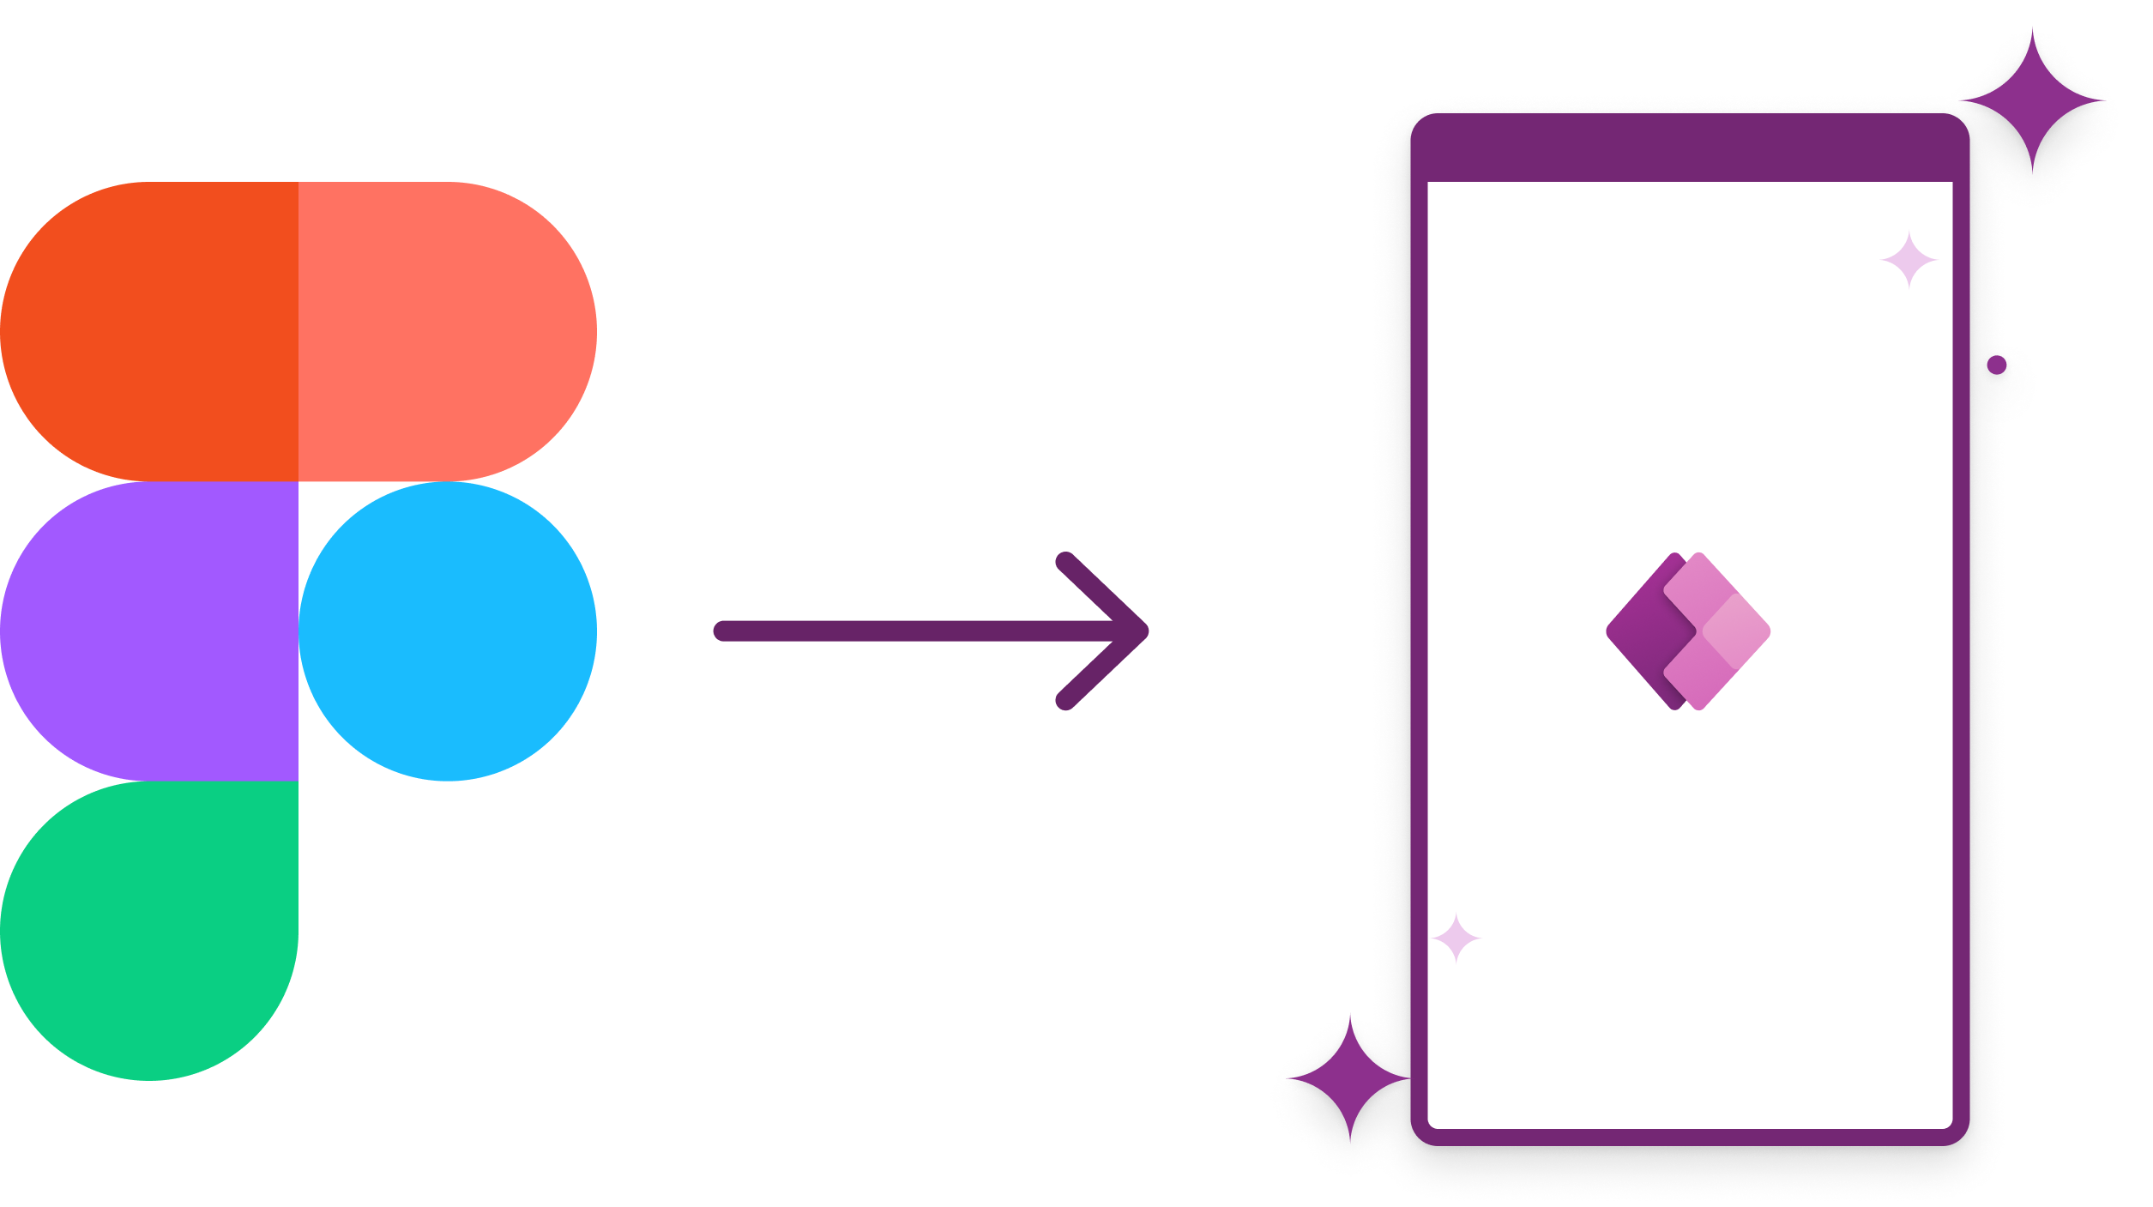
Coming soon
Features that will provide greater flexibility to extend or customize Power Pages for Pro-developers
PWA’s
Express Design
Converting functional portals as a cross-platform is supported Progressive Web Application(Automatic support in Power Pages)
Still to evolve in terms of iOS Support
Integrating the upcoming Power Platform Express Design features such as converting Figma designs, Images or PDF files into Power Pages.
This ability is already seen through Power Apps Figma UI Kit for PowerApps Development.

Slide 13

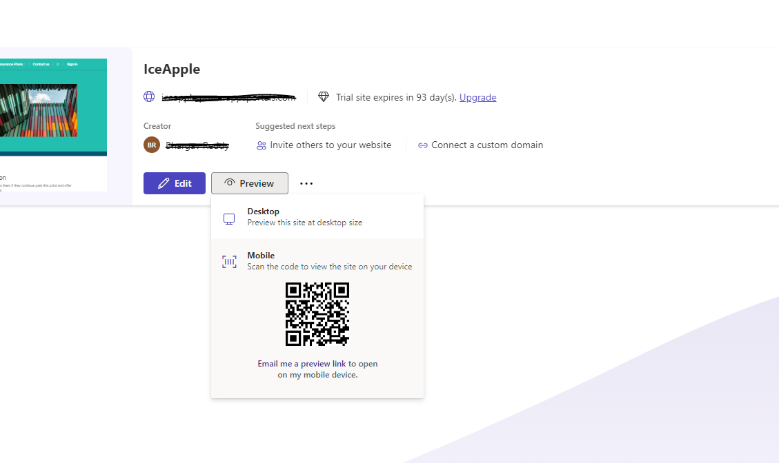
Home Tab
The Home tab of Root URL lists all the sites that are created and provides the following abilities.
Create a New Site(dependent on available capacity)
Share, Manage & Delete Existing Sites
Preview Existing Sites

Slide 14
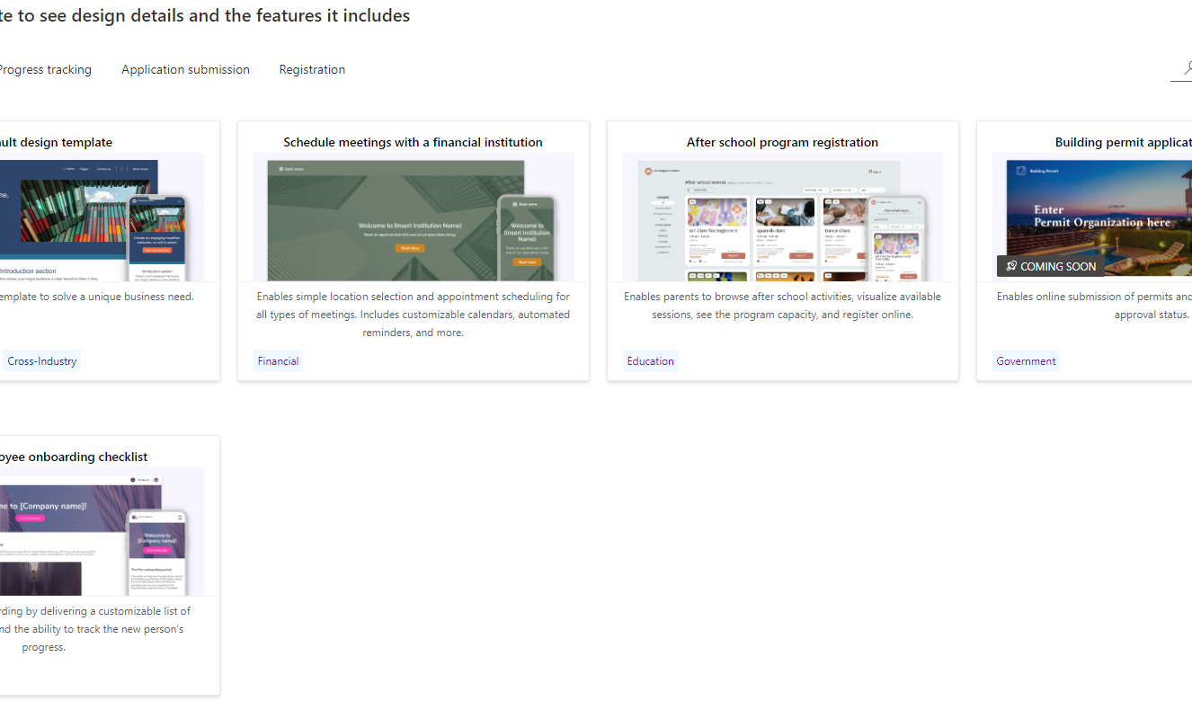
Available Templates
There are five readily available templates that can be leveraged to create sites from the Root URL.
Default Design Template
Schedule Meetings with a Financial Institution
After School program registration
Building Permit Application
Employee Onboarding Checklist
Site Design Series

Slide 15
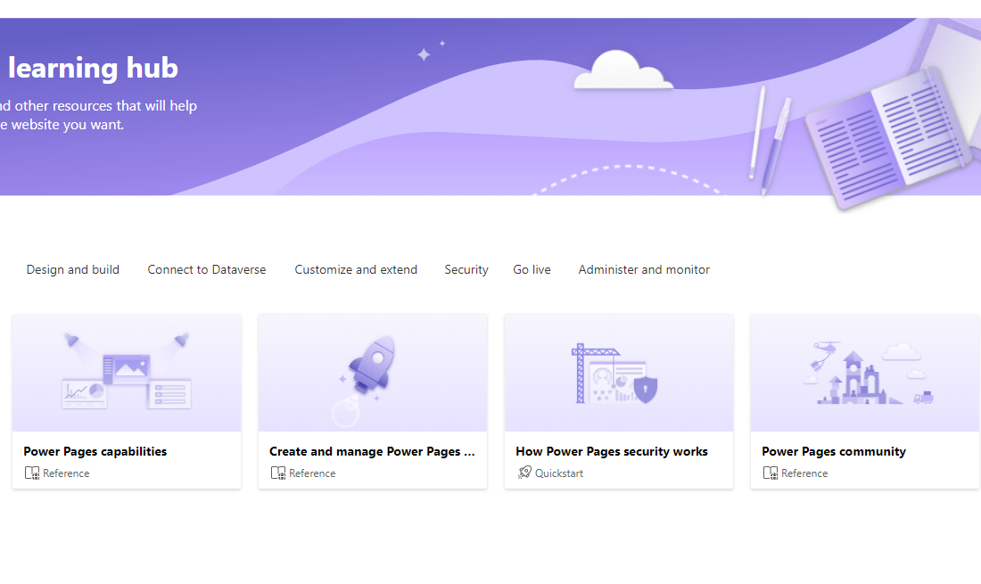
Integrated Learning Hub
The root URL to access power pages is as below and contains a dedicated tab for Learning all the latest happenings around Power Pages and accessing all existing resources.
Root Url: https://make.powerpages.microsoft.com

Slide 16
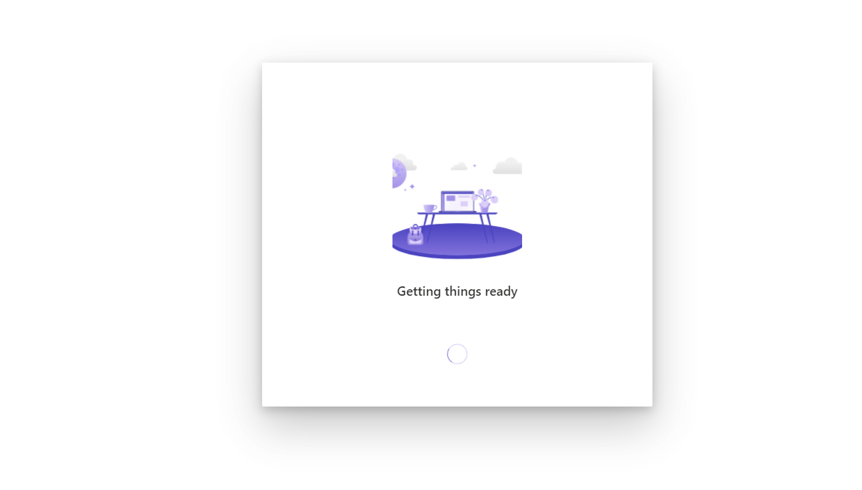
Workspaces
When a particular site is chosen to be edited, below are some available tabs/options. Microsoft will be adding more integration ends to these workspaces.
Pages Workspace
Styling Workspace
Data Workspace
Set up Workspace
Admin Workspace(…)

Slide 17
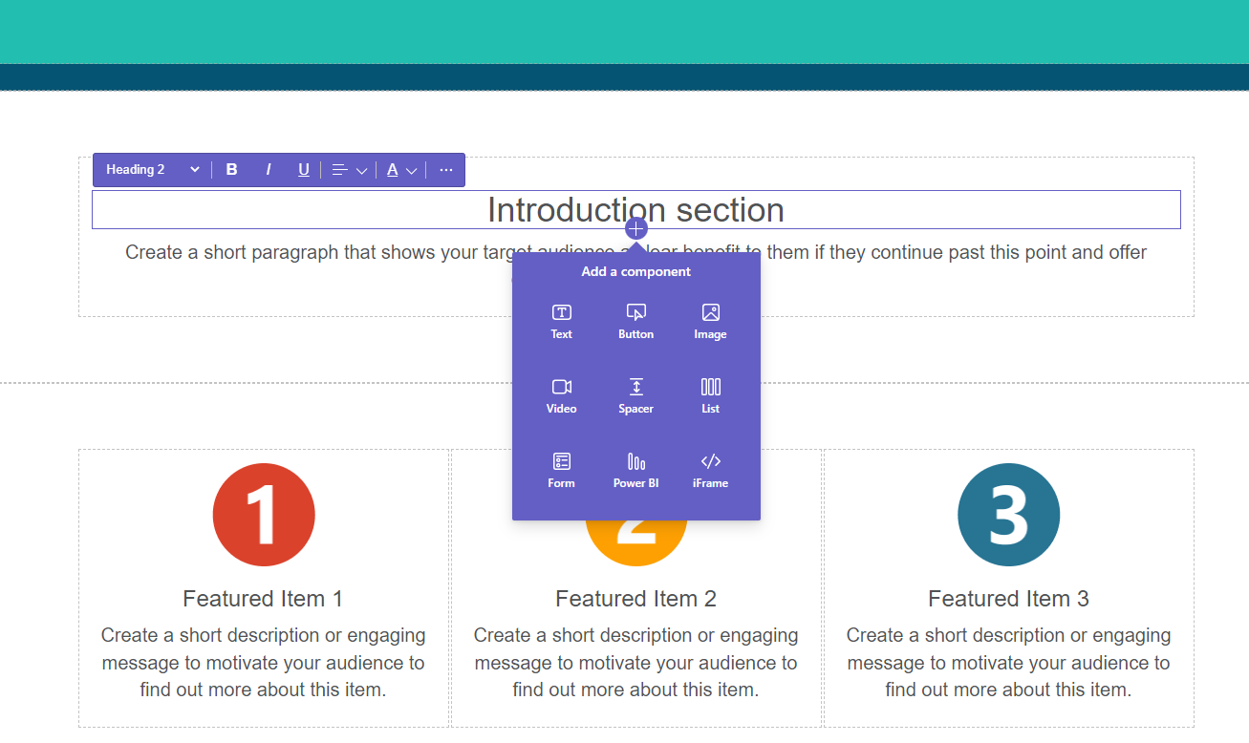
Pages Workspace
A dedicated workspace to create, modify, manage the site pages along with the site navigation
Also, provides the ability to create sub pages
A WYSIWYG Editor to add sections to the pages(1, 2, 3 column layouts..) components such as Text, Image, Button, Video, Spacer, List, Form, Iframe, PowerBI

Slide 18
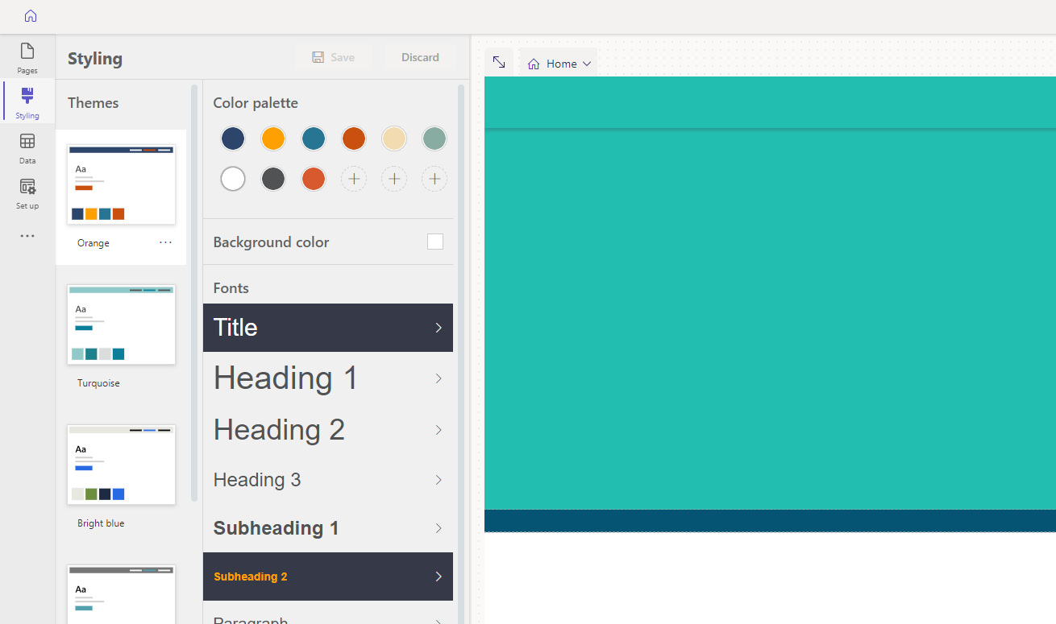
Styling Workspace
A dedicated workspace to modify themes and apply styling elements to the site.
Several OOB themes are available and option for creating Custom Themes using Custom CSS is enabled too.

Slide 19
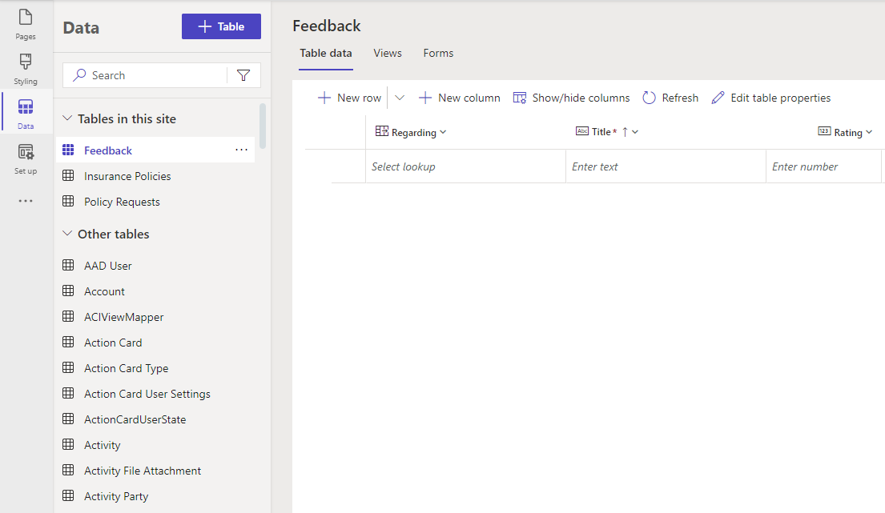
Data Workspace
A dedicated workspace that currently loosely integrates with Microsoft Dataverse
It provides the ability create, modify, manage the Dataverse Tables and their properties and permissions
It also provides the ability to access the Standard Dataverse Tables apart from the Custom Tables

Slide 20
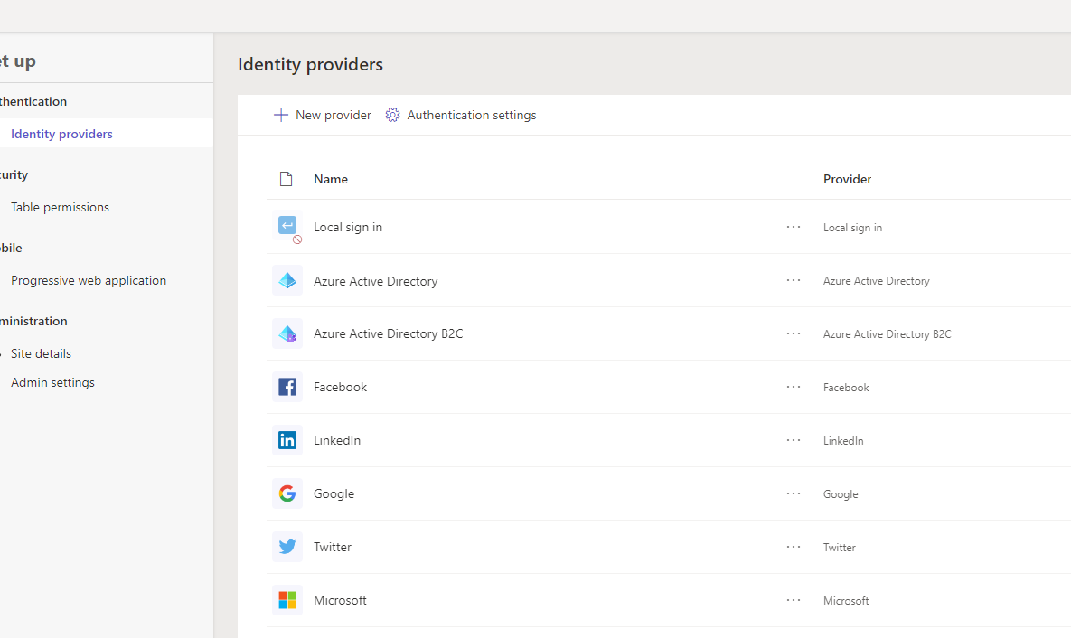
Setup Workspace
A dedicated workspace to handle Authentication, Security, Mobility and Administration aspects of the Entire Site.
Provides ability to configure authentication for a few providers such as Google, LinkedIn, Twitter, Microsoft etc.
Ability to add Custom authentication providers is enabled such as SAML, OIDC etc.

Slide 21
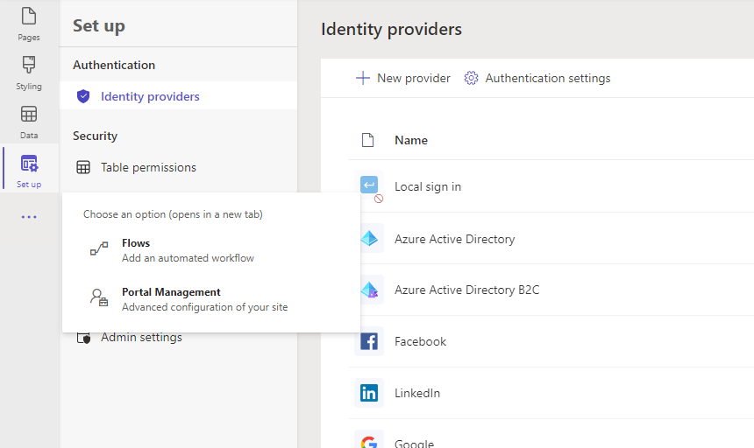
Admin Workspace
A dedicated workspace to create, modify, manage Flows but still largely relies on the root URL for Microsoft Power Automate and redirects currently
For some key features, Pages foundation is still largely reliant & redirected to Power Portal Management App

Slide 22
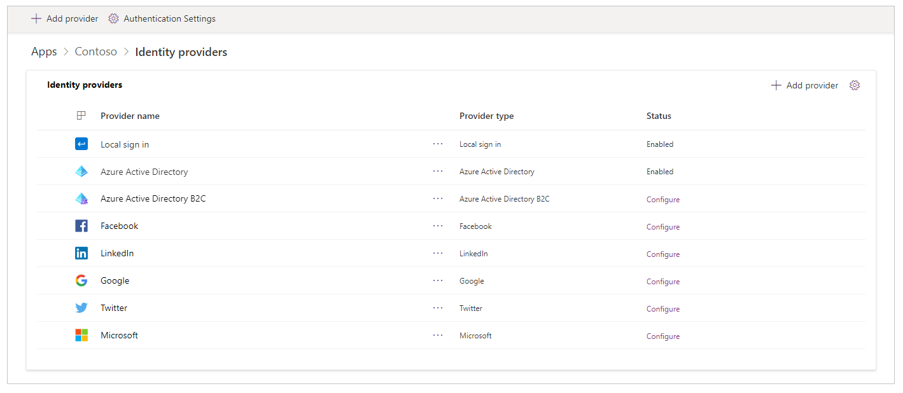
Power Pages Authentication
Power Portals/Pages provides the following options to enable authentication on the site.

Slide 23
It is just after lunch, wake me up please!
Quiz 1: Which is the nearest star to Earth?
Proxima Centauri
Wolf 359
Helios, Sun or Sol
Sirius A

Slide 24
DEMO 1: Building a Dynamic Image Carousel using Dataverse Entity Data using Fetch XML and Liquid!

Slide 25
Right, One more wake up call!
Quiz 2: In the famous American television sitcom “The Big Bang Theory, who does Jim Parsons play?
Rajesh Koothrapalli
Leonard Hofstadter
Howard Holowitz
Sheldon Lee Cooper

Slide 26
DEMO 2: Building a Page that uses Portals Web API to bind Entity List Data to a jQuery Data Tables!

Slide 27
Okay, Last wake up call!
Quiz 3: Who is the first Indian amongst the below to win a Nobel Prize and when?
Sri Aurobindo in 1950
C V Raman, 1930
Rabindranath Tagore, 1913
Har Gobind Khorana in 1968

Slide 28
DEMO 3: Building a Page that displays Bing Map Coordinates stored in Dataverse Entity Data using Liquid, Fetch XML and JavaScript!

Slide 29
QUESTIONS
https://www.linkedin.com/in/bhargavreddynuthanakalva
@ronnybhargav
Or drop in an email to ronnybhargav@gmail.com

Slide 30







A Big Thank You to all the Sponsors!
Diamond:
Learning Partner:
Platinum:
Gold:

Slide 31

SPEAKER PROFILE
Next Session
Track 2
Hands on with automating Azure AD with MS Graph
45 minutes
Anustup Mukherjee
AI Software Engineer
Newton School

